Slide 1





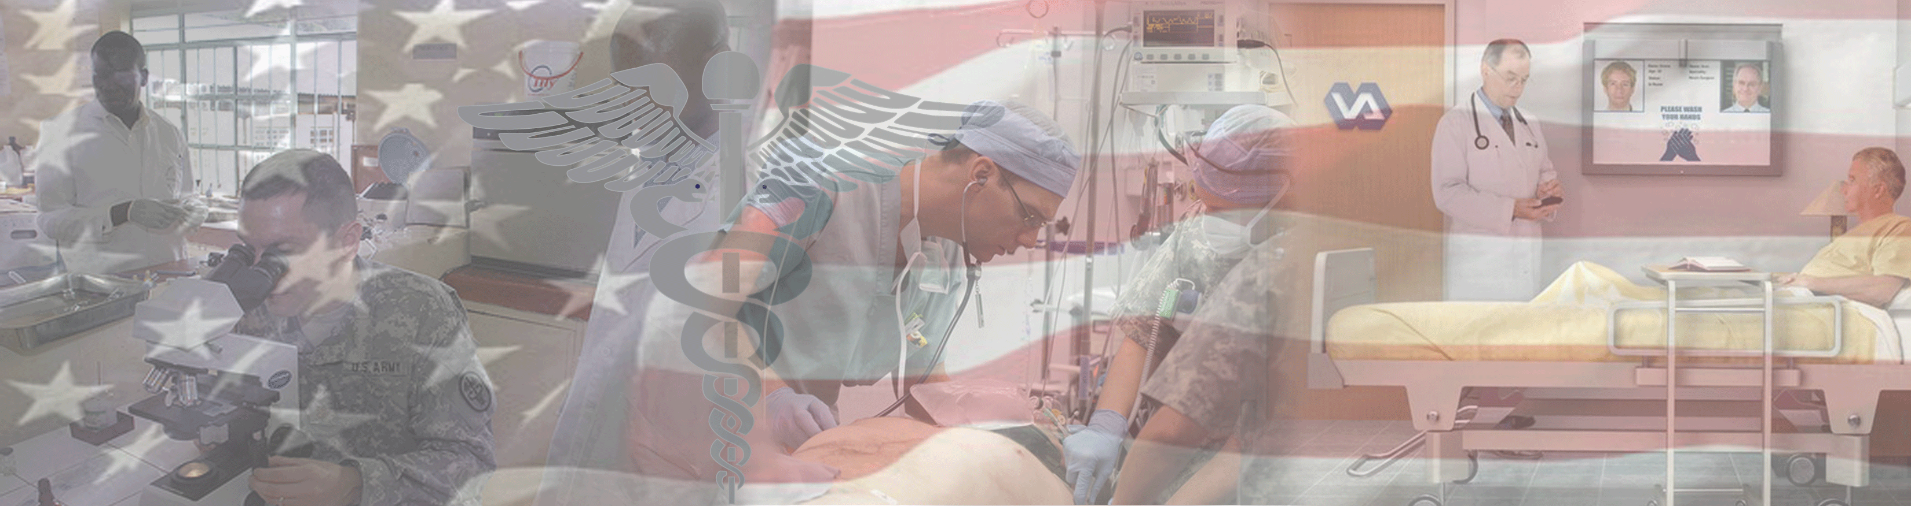

By Light Professional IT Services LLC
www.bylight.com
XDS on FHIR
John Moehrke
<John.Moehrke@byLight.com>
Co-Chair: IHE ITI Planning Committee

Slide 2
Agenda - Using FHIR to get to XDS/XCA published Documents
Document Sharing – as a given
FHIR access to Documents
MHD –> XDS on FHIR
Support profiles: IUA, PDQm, PIXm, mCDS
Decomposed into Elements/Resources
mXDE + QEDm
Using Provenance – to get back to source documents
MHD
Conclusion
Experiment

Slide 3
























IHE Standards-based HIE (XDS) Key Components
Patient ID Manager
PRIMARY CARE PHYSICIANS
Practice Management
EMR
PATIENT
Personal Health Records
Document Registry
Document Repositories
LAB
Results
PUBLIC HEALTH
Registries
PAYERS
Claim Data
HOSPITAL 2
EMR/PM’s
Lab
PACS Archive
PHARMACY/PBMs
RX History
SPECIALTY PRACTICE
Practice Management
EMR
HOSPITAL 1
EMR/PM’s
Lab
PACS Archive
Notes:
See http://healthcaresecprivacy.blogspot.com/p/topics.html#HIE

Slide 4

IHE Standards-based HIE (XCA) Community Document Sharing
XCA Gateway
Patient ID Manager
PRIMARY CARE PHYSICIANS
Practice Management
EMR
Patient ID Manager
PRIMARY CARE PHYSICIANS
Practice Management
EMR
Document Registry
PATIENT
Personal Health Records
Document Registry
PATIENT
Personal Health Records
Document Repositories
Document Repositories
LAB
Results
LAB
Results
PUBLIC HEALTH
Registries
PAYERS
Claim Data
PUBLIC HEALTH
Registries
PAYERS
Claim Data
EHR
PHARMACY/PBMs
RX History
HOSPITAL 2
EMR/PM’s
Lab
PACS Archive
PHARMACY/PBMs
RX History
HOSPITAL 2
EMR/PM’s
Lab
PACS Archive
SPECIALTY PRACTICE
Practice Management
EMR
HOSPITAL 1
EMR/PM’s
Lab
PACS Archive
SPECIALTY PRACTICE
Practice Management
EMR
HOSPITAL 1
EMR/PM’s
Lab
PACS Archive
Notes:
See http://healthcaresecprivacy.blogspot.com/p/topics.html#HIE

Slide 5
Principles of a Document
Persistence – A Document continues to exist in an unaltered state, for a time period defined by local and regulatory requirements. Note documents outlive the servers (and often the syntax), on which they are created.
Stewardship –A document is maintained over its lifetime by a custodian, either an organization or a person entrusted with its care.
Potential for authentication - A clinical document is an assemblage of information that is intended to be legally authenticated.
Context - A clinical document establishes the default context for its contents
Wholeness - A document is a whole unit of information. Parts of the document may be created or edited separately, or may also be authenticated or legally authenticated, but the entire document is still to be treated as a whole unit.
Human readability – a document is human readable
Notes:
See https://healthcaresecprivacy.blogspot.com/2013/11/distinction-between-documents-and.html
True of both CDA documents and FHIR documents

Slide 6
Various Formats and Encodings
XDS/XCA are content agnostic
Metadata enable discovery
CDA, C-CDA, C32, etc
FHIR Documents
DICOM Documents
PDF/Text
Graphics (JPEG, MPEG, TIFF…)
Special (On-Demand, Delayed)
EMR
CCDA
2.1
CCDA
1.1
C32
PDF
FHIR
Notes:
See https://healthcaresecprivacy.blogspot.com/2015/10/ihe-formatcodes-are-mandatory.html

Slide 7
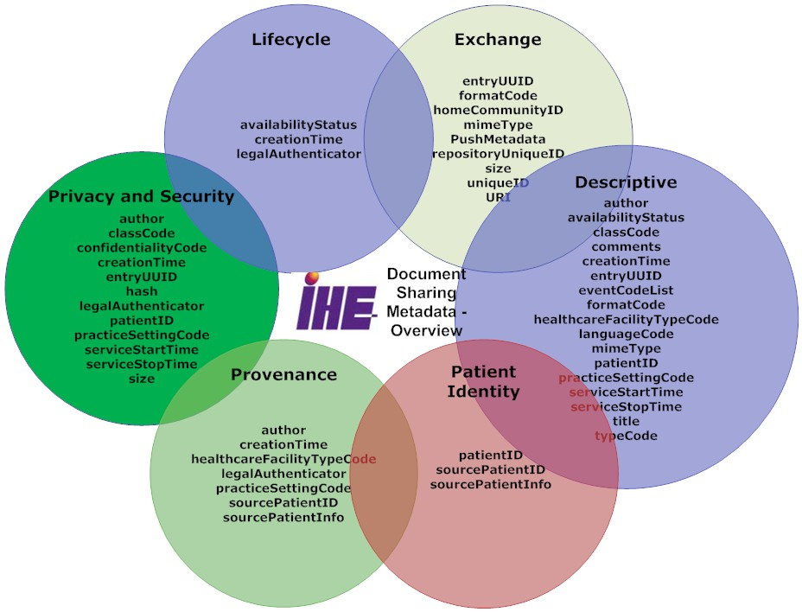
Metadata – enables discovery

Slide 8
Mobile access to Health Documents (MHD)
Provide FHIR based methods of publishing and accessing Document Sharing
Enable publication of Documents by Apps
Enable Discovery of available documents by Apps
Retrieval of the Document content
XDS on FHIR
Details https://wiki.ihe.net/index.php/MHD
Superset alignment with US Core – DocumentReference
http://build.fhir.org/ig/HL7/US-Core/StructureDefinition-us-core-documentreference.html
All these requirements are consistent with MHD, they are a subset of MHD requirements

Slide 9
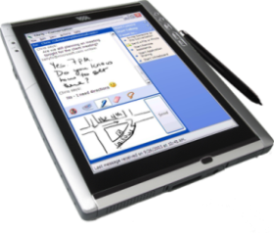
MHD as API to XDS
Patient Identity Source
XDS Document Registry
XDS Document Consumer
MHD Document Responder
MHD Document Recipient
XDS Document Source
XDS Document Repository
MHD Document Source
MHD Document Consumer
Notes:
In order to enable a mobile application to access an XDS environment, bridging code is used to implement an MHD document recipient or Document Responder which can be connected to by an MHD Document Source or Document Consumer on a mobile device.

Slide 10
MHD as API to XCA
XCA Responding Gateway
XCA Initiating Gateway
MHD Document Responder
XDS Document Registry
XDS Document Repository
MHD Document Consumer

Slide 11
Support Profiles
PDQm, PIXm – Patient lookup
IUA – an Oauth profile complementary to SMART-on-FHIR
ATNA – secure http specification, and AuditEvent specification
mCSD – Directory of Provider, Organization, and Health Services

Slide 12
Provide Document Bundle Transaction (Publication request)
Publish
Used mostly with XDS Reg/Rep
to publish new documents, or
replace old documents with new
Push
Used to send documents
Bundle (Create Transaction)
DocumentManifest
DocumentReference
Binary
DocumentReference
Binary
DocumentReference
Binary
List (Folder)
*Patient*
Document Source
Document Recipient
Notes:
DocumentManifest – Why is this group being Pushed or Published? – Why, To Whom, From Whom, When
DocumentReference – metadata about the document – what kind of document, author, service timeframe, based on, mimeType, formatCode
Binary – The document bits.
List – Folder
*Patient* - maybe present. In XDS is usually a reference to a Patient

Slide 13
Query Transactions – simply normal FHIR queries
DocumentReference
Patient – required parameter
classCode, practiceSetting, timeframe
Others
DocumentManifest
Patient – required parameter
classCode, practiceSetting, timeframe
recipient
Document Responder
Document Consumer

Slide 14
Conformance Resources
IHE MHD Implementation Guide
URI http://ihe.net/fhir/ImplementationGuide/IHE.MHD
FormatCode CodeSystem
URI http://ihe.net/fhir/ValueSet/IHE.FormatCode.codesystem
Identifier urn:oid:1.3.6.1.4.1.19376.1.2.3
FormatCode ValueSet
URI http://ihe.net/fhir/ValueSet/IHE.formatcode.vs
Identifier urn:oid:1.3.6.1.4.1.19376.1.2.7.1
Actor Capability Statements
MHD Document Source Actor CapabilityStatement
URI http://www.ihe.net/fhir/CapabilityStatement/IHE.MHD.DocumentSource
MHD Document Recipient Actor CapabilityStatement
URI http://www.ihe.net/fhir/CapabilityStatement/IHE.MHD.DocumentRecipient
MHD Document Responder Actor CapabilityStatement
URI http://www.ihe.net/fhir/CapabilityStatement/IHE.MHD.DocumentResponder
MHD Document Consumer Actor CapabilityStatement
URI http://www.ihe.net/fhir/CapabilityStatement/IHE.MHD.DocumentConsumer
Structure Definitions
Document Manifest
URI http://ihe.net/fhir/StructureDefinition/IHE.MHD.DocumentManifest
List (Folder)
URI http://ihe.net/fhir/StructureDefinition/IHE.MHD.List
DocumentReference from Query with Comprehensive Metadata
URI http://ihe.net/fhir/StructureDefinition/IHE.MHD.Query.Comprenensive.DocumentReference
DocumentReference from Query with Minimal Metadata
URI http://ihe.net/fhir/StructureDefinition/IHE.MHD.Query.Minimal.DocumentReference
DocumentReference in Provide with Comprehensive Metadata
URI http://ihe.net/fhir/StructureDefinition/IHE.MHD.Provide.Comprehensive.DocumentReference
DocumentReference in Provide with Minimal Metadata
URI http://ihe.net/fhir/StructureDefinition/IHE.MHD.Provide.Minimal.DocumentReference
MHD Provide Document Bundle with Minimal Metadata (ITI-65)
URI http://ihe.net/fhir/StructureDefinition/IHE.MHD.ProvideDocumentBundle.Minimal
MHD Provide Document Bundle with Comprehensive Metadata (ITI-65)
URI http://ihe.net/fhir/StructureDefinition/IHE.MHD.ProvideDocumentBundle.Comprehensive

Slide 15
Documents are not optimal for FHIR clients
MHD eliminates the need to understand SOAP and ebXML . It does enable API use of JSON or simple XML.
But Document format not changed
They are various formats (PDF, DICOM, CDA, CCR, etc)
CDA XML is not simple XML
Apps tend to want summary without duplicates
Yet
Apps will eventually need to know the integrity and authenticity of the data
Apps may need to reference the source
Many CDA today are just EHR data dumps – a Current Medical Summary
FHIR provides nice sized chunks
Note: MHD Retrieve Document could support service that converts the original document to FHIR-Document

Slide 16
Query for Existing Data for Mobile (mQED)
Supports queries for clinical data elements (e.g., observations, allergies, etc.) by making the information widely available to other systems within and across enterprises
Aimed at class of systems that are resource- and platform-constrained (e.g., tablets, smartphones, and embedded devices including home-health devices)
Same as US Core
Observation,
AllergyIntolerance,
Condition,
DiagnosticReport,
Medication,
MedicationStatement,
MedicationRequest,
Immunization,
Procedure,
Encounter,
Provenance,
OperationOutcome,
Bundle
Source: https://wiki.ihe.net/index.php/Query_for_Existing_Data_for_Mobile

Slide 17
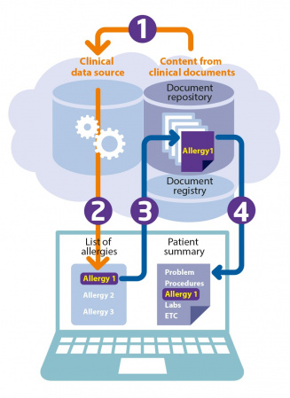
Mobile Cross-Enterprise Document Data Element Extraction (mXDE)
Provides means to access data elements extracted from shared structured documents
Enables the deployment of health data exchange infrastructures where fine-grained access to health data coexists and complements the sharing of coarse-grained documents and the fine-grained data elements they contain
Observation, AllergyIntolerance, Condition, DiagnosticReport, Medication, MedicationStatement, MedicationRequest, Immunization, Procedure, Encounter, Provenance, OperationOutcome, Bundle
Source: https://wiki.ihe.net/index.php/Mobile_Cross-Enterprise_Document_Data_Element_Extraction

Slide 18
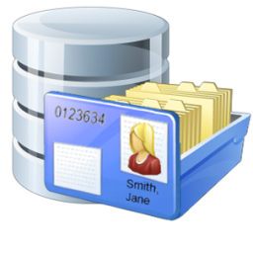



Resources
Shared Documents (XDS)
Observation
Obs 1
Obs 2
Obs 3
Med Summary
EHR
Medication
Med 1
Med 2
Med 3
Episode
2/7/1989
Lab/Rad
Allergy
Al 1
Al 2
Al 3
Discharge
Summary
1/2/2002
…
Immunization
Imm 1
Imm 2
Imm 3
EMR
Etc…
Provenance
Prov 1
Prov 2
Prov 3

Slide 19
Using Provenance
Determine how often the issue is referenced (1 document vs all)
Determine who has published the issue
Pull the metadata -- DocumentReference
Pull the Document
Model for Provenance
One Provenance for each Document
Where a data Resource came from many documents, it will have many Provenance.target pointing at it
Provenance.target → 1..* Resources (the resources that came from this document)
Provenance.recorded → when the decomposition happened (might inform cache)
Provenance.policy == “urn:ihe:pcc:qedm:2017:document-provenance-policy”
Provenance.agent → the software “ASEMBLER” that decomposed this document into these target Resources
Provenance.entity → the DocumentReference representing this document

Slide 20
Conclusion
Enabling technology for FHIR accessibility of Document Sharing
Document Metadata Query
Publication of Documents
Get Decomposed Resources
Get Provenance, so that get source Document

Slide 21

Questions?
John Moehrke
Gmail JohnMoehrke
Twitter JohnMoehrke
Skype johnmoehrke
Blog healthSecPrivacy.blogspot.com

Slide 22
Bonus – Things not in the IHE Profiles
When using MHD, one could retrieve the Binary (Document) with http negotiate only indicating FHIR resources.
Using C-CDA on FHIR http://hl7.org/fhir/us/ccda/history.html
Automatic conversion of a well formed C-CDA to FHIR Document
Use of Subscription to get Async API giving more responsive App environment, while backend deals with very slow response from nationwide partners (slowness due to scale of the network, and slowness of some partners)

Slide 23
Experiment
Firely – servers have some DocumentReference given patient XXXX
IHE-Connectathon tools
http://wiki.ihe.net/index.php/IHE_Test_Tool_Information
http://ihe.wustl.edu/gazelle-na/home.seam (requires you create an account)
Simplifier published conformance resources
https://wiki.ihe.net/index.php/MHD

